Slide 1
Reverse Engineering
An introduction to Reverse engineering, the tools and assembly
Chris Estes

Slide 2
What is Reverse Engineering?
When you take a final product (e.g. a compiled program) and attempt to break it down and understand what it’s doing, and possibly modifying it for a new purpose.
This involves the use of specialized tools such as debuggers and disassemblers
Debuggers allow you monitor things live as they happen
Disassemblers attempt to analyze the program and show you what it looks like in assembly

Slide 3
Why would you need to reverse engineer something?
When you have a program that you don’t have the source code for but what to find out how it does things
Improving/modifying something you don’t have the source code for
This may not be legal for every program out there, so exercise it with caution

Slide 4
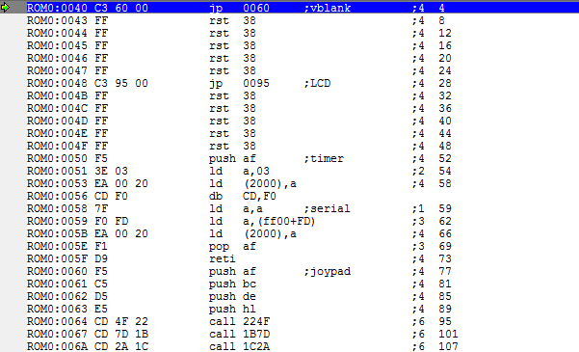
We’ll be looking at reverse engineering through “romhacking”

Slide 5
Why romhacking?
It’s in a bit of a grey area, however, many hobbyists have written highly specialized and useful debuggers/emulators that can help one learn this process
A game is a good way to break into reverse engineering (and by extension assembly)
It’ll be easier to work with gameplay concepts as things we want to find/alter

Slide 6
Why does it have to be in assembly?
There is no real way to convert something back from a compiled format to the original source code
The best we can manage is turning it back into assembly
Don’t be scared of assembly! It is daunting at first but it’s a good skill to have
High Level Language
Compiler
Executable File (Machine Code /Assembly)

Slide 7
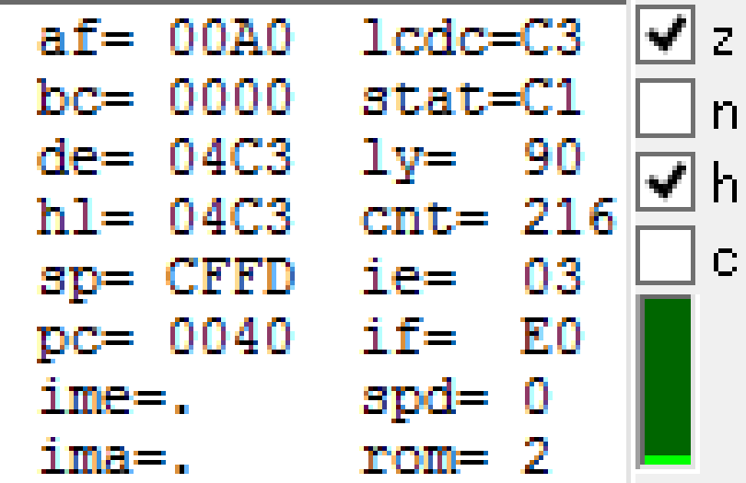
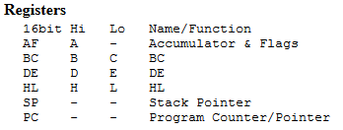
The CPU
Registers – storage locations, values move around here
Processor Status/Flag Register – keeps track of flags that are set during calculations
Program Counter – address of current instruction
Stack Pointer – keeps track of call stack

Slide 8
Assembly Basics
Basic operators:
add, sub, mul*, div*
mov (move):
copies value from source and puts it into the destination.
You will probably see this instruction a lot.
jmp (jump) and other conditional jumps:
used to hop to certain addresses
nop:
no operation (I believe it’s used for when you need to wait)
*older, simpler CPUs might not have those luxuries, you may have to do your
multiplication/division through bit-shifting
A very basic example.
I highly recommend keeping a reference
document up while working on assembly to make it simpler.

Slide 9
Basic approach to reverse engineering
Task we want to accomplish
-> hunt for relevant info (such as RAM addresses & values)
-> set breakpoints (freeze CPU during a certain action)
-> slowly trace through instructions and attempting to figure things out
-> modify (test & check) OR document how it works

Slide 10
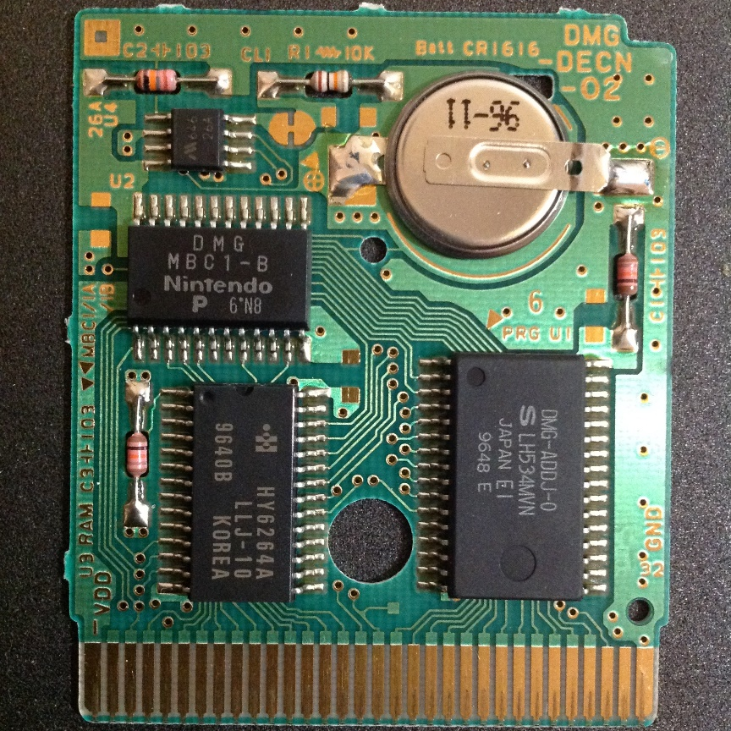
Our Target: The GameBoy
The Specs
CPU :
Sharp LR35902 @ 4.19 MHz
Display:
2.6” LCD
Resolution:
160x144px
Media:
ROM Cartridges
A Gameboy cartridge PCB.

Slide 11
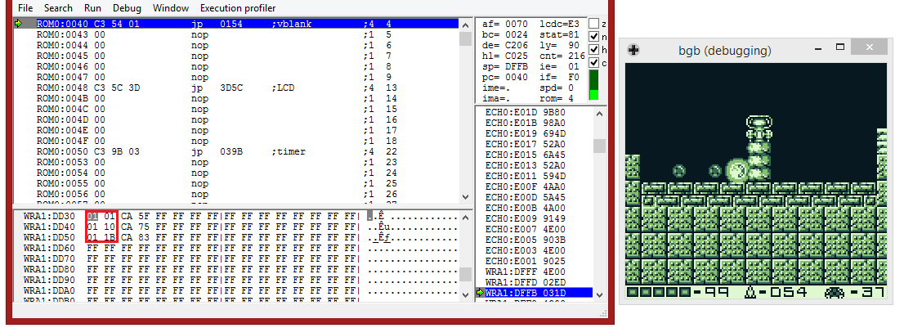
Metroid II
Changing bomb timers
DDX0 – Bomb State, DDX1 – Bomb Timer

Slide 12
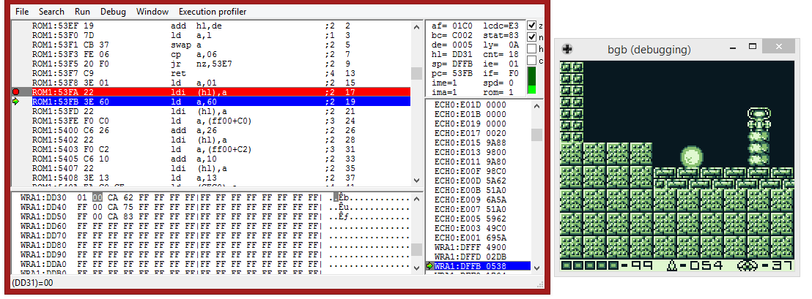
After searching we find that setting the timer is quite simple.

Slide 13
This one (thankfully) was quite simple and very easy to modify.

Slide 14
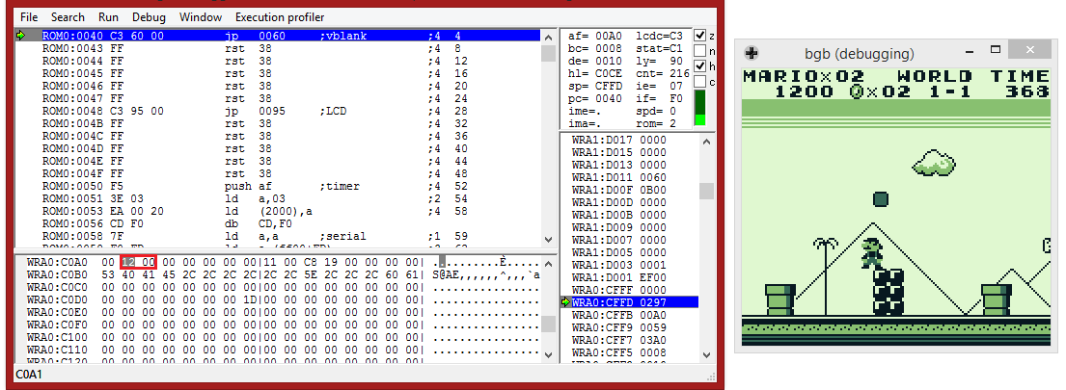
Super Mario Land
How does the score update?
Score is stored at RAM values C0A0 – C0A2

Slide 15
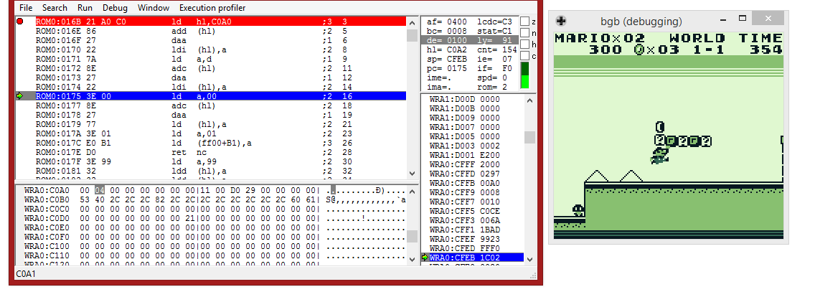
After a lot of searching, we stumble upon this routine.

Slide 16
Basically HL points to location in ram,
point value is loaded from register D,
then moved to register A,
and score is tabulated and stored back to
target RAM Location.

Slide 17
Things to remember:
Assembly can be a valuable asset, it’s quite confusing at first
but debugging a program (that you have source code access
to or not) is an invaluable tool for fixing problems!
Reverse Engineering is a challenging process but you’ll learn quite a lot
about a program and the architecture it’s designed for
Don’t ever be afraid to dive into assembly, it may look scary but
given enough time you can figure things out and will learn
a lot of useful info

Slide 18
THE END!

